Slide 1
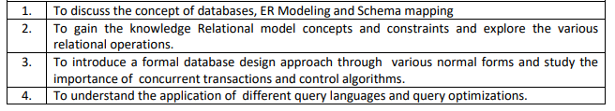
COURSE DETAILS Course: Database Management System(DBMS) Code : 22CS43(3-0-2) Sem : 4 Course learning objectives:

Slide 2
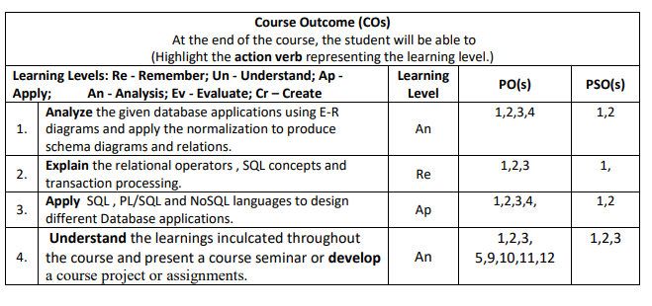

Slide 3
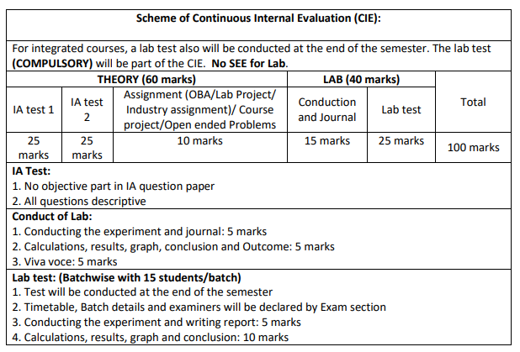

Slide 4
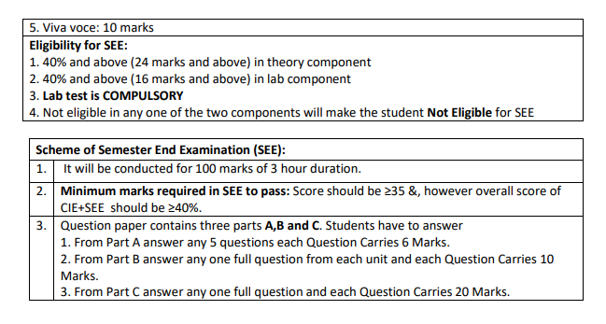

Slide 5
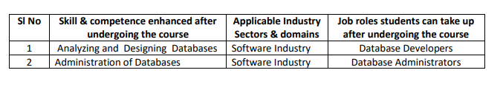
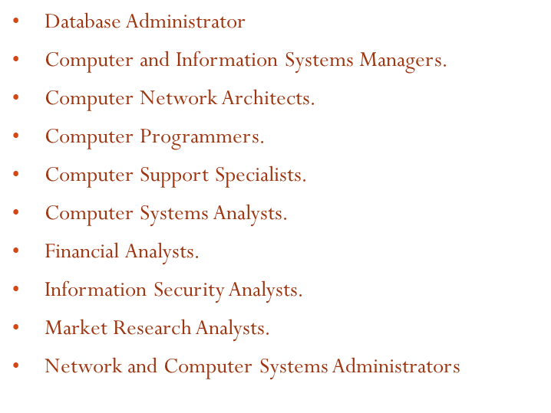
Career opportunities in DBMS

Slide 6
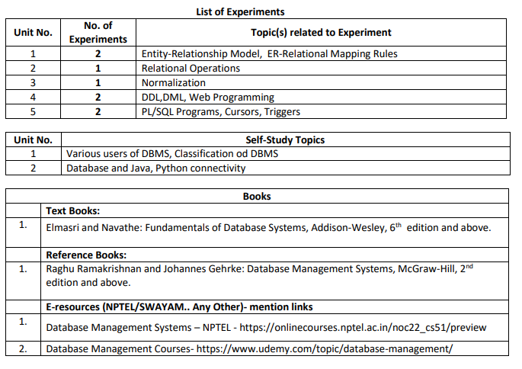

Slide 7
Introduction to Database Management System
Data: facts that can be recorded and stored
Database:
A database is a collection of related data.
A database can be of any size and complexity.
DBMS:
A database management system (DBMS) is a collection of programs that enables users to create and maintain a database.
The DBMS is a general-purpose software system that facilitates the processes of defining,
constructing, manipulating, and sharing databases among various users and applications.
Database System:
The DBMS software together with the data itself is database system.

Slide 8
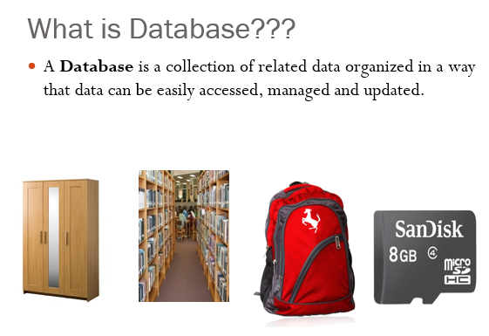

Slide 9
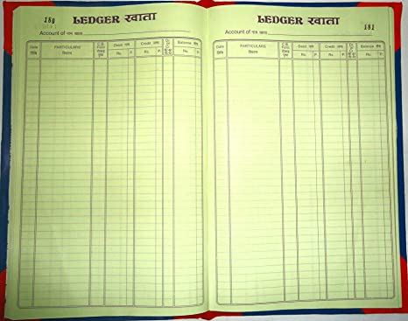

Create, Store, Maintain,& Share Data
Then
Now

Slide 10
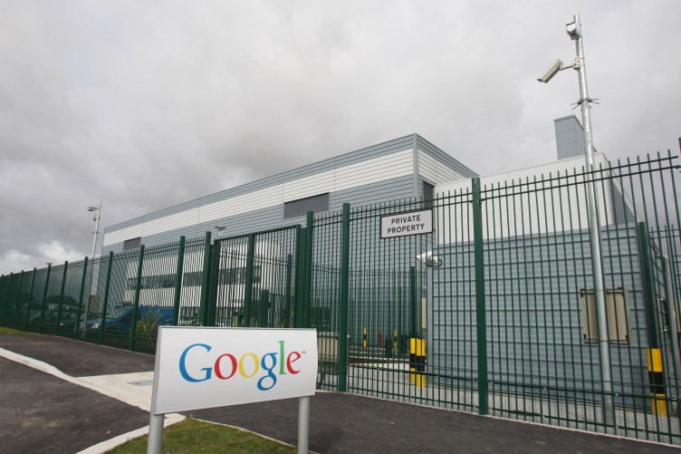

A database can be of any size and complexity.

Slide 11
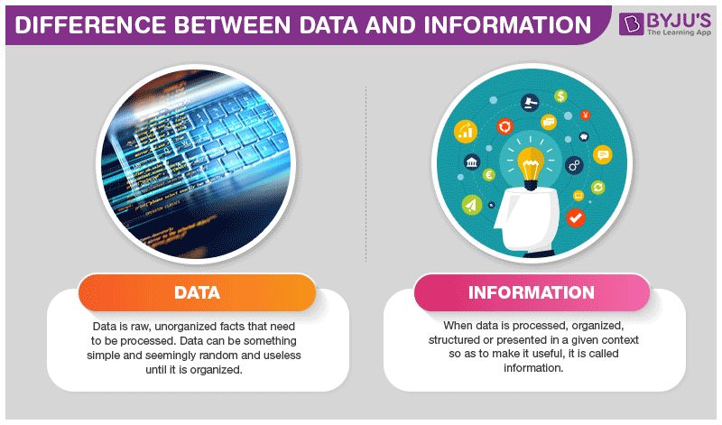
Data vs. Information

Slide 12
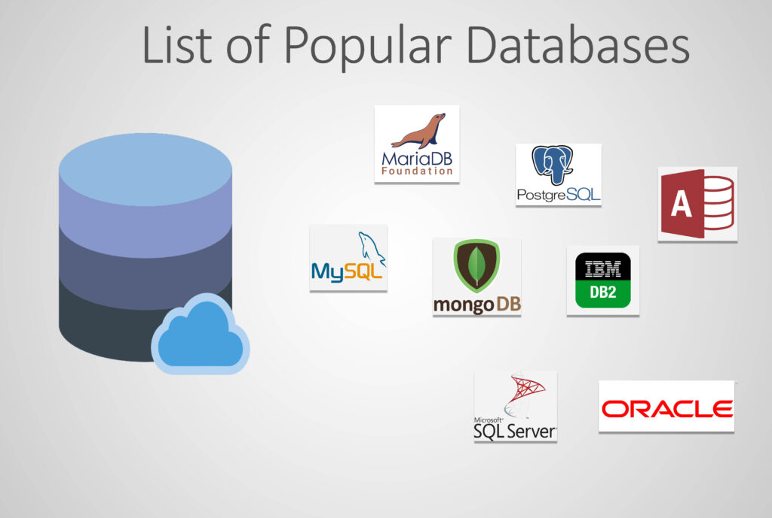

Slide 13
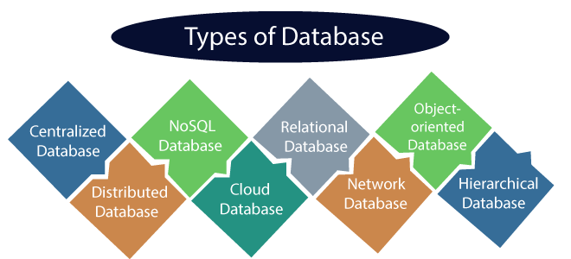
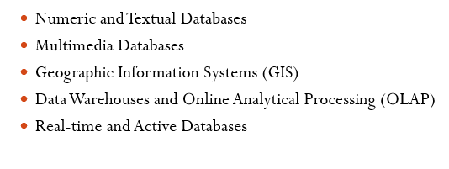

Slide 14
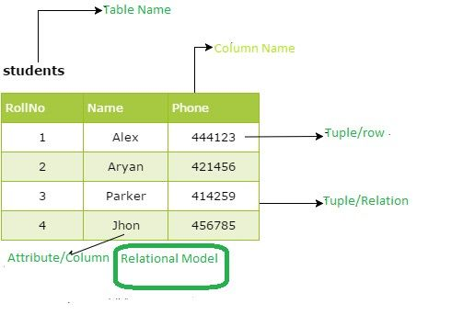
Relational Database(RDBMS)

Slide 15
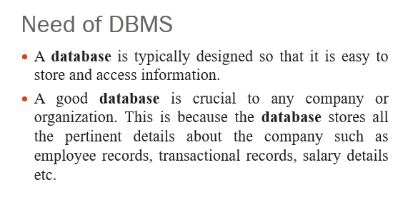

Slide 16
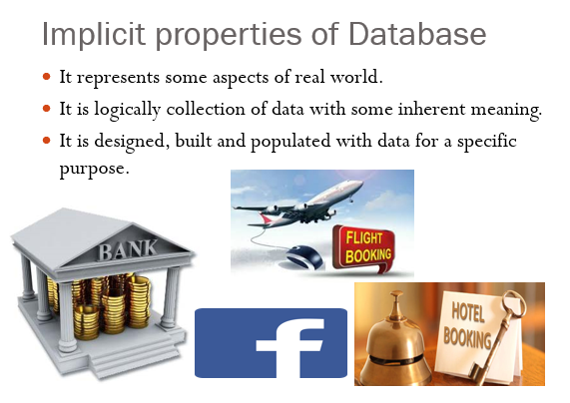

Slide 17
Typical DBMS Functionality
Define a database : in terms of data types, structures and constraints
Construct or Load the Database on a secondary storage medium
Manipulating the database : querying, generating reports, insertions, deletions and modifications to its content
Concurrent Processing and Sharing by a set of users and programs – yet, keeping all data valid and consistent

Slide 18
Typical DBMS Functionality
Other features:
Protection or Security measures to prevent unauthorized access
“Active” processing to take internal actions on data
Presentation and Visualization of data to the end users

Slide 19
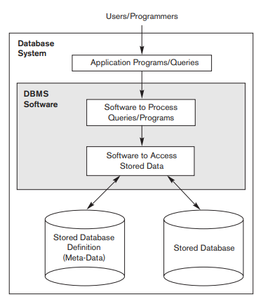
A Simplified Database System Environment.

Slide 20
Characteristics of the Database Approach
Self-describing nature of a database system
Insulation between programs and data, and data abstraction
Support of multiple views of the data
Sharing of data and multiuser transaction processing

Slide 21
1. Self-describing nature of a database system
The database system contains not only the database itself but also a complete definition or description of the database structure and constraints, which is known as metadata.
This metadata is stored in DBMS catalog and is used by the DBMS software and also by database users who need information about the database structure.
The DBMS software must work equally well with any number of database as long as the database definition is stored in the catalog.
In traditional file processing, data definition is typically part of the application programs themselves. Hence, these programs are constrained to work with only one specific database.

Slide 22
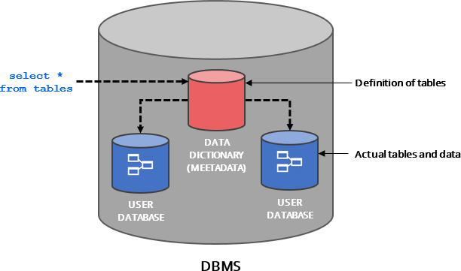
1. Self-describing nature of a database system
(METADATA)

Slide 23
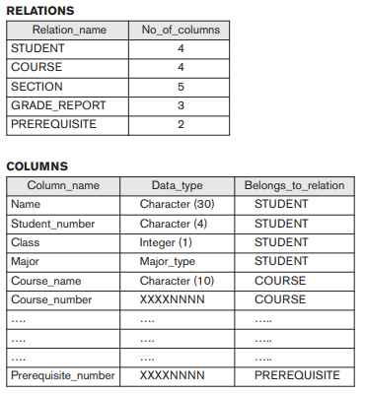
An example of a database catalog for the database

Slide 24
2. Insulation between programs and data, and data abstraction
In traditional file processing, the structure of data files is embedded in the application programs, so any changes to the structure of a file may require changing all programs that access that file.
DBMS provides program-data independence property i.e. The structure of data files is stored in the DBMS catalog separately from the access programs.
Some object oriented databases provides program-operation independence, an operation as two parts one is interface(signature) and the other is implementation(or method). Interface can be changed without changing the implementation
The characteristic that allows program-data independence and program-operation independence is called data abstraction.

Slide 25
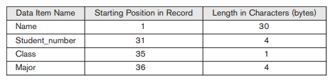
A DBMS provides users with a conceptual representation of data that does not include many of the details of how the data is stored or how the operations are implemented
Internal storage format for a STUDENT record, based on the database catalog

Slide 26
3. Support of Multiple Views of the Data
A database typically has many types of users, each of whom may require a different perspective or view of the database.
A view may be a subset of the database or it may contain virtual data that is derived from the database files but is not explicitly stored.

Slide 27





Implementers of the Application
Different Users of the Application
CEO
Data Analysis
1. Loss/Profit Yearly
2. Project Details etc
Developers
Managers
Projects
Data base
Employees
Profile
Projects
Office Staff
Billing
Salary etc

Slide 28
4. Sharing of Data and Multiuser Transaction Processing
A multiuser DBMS, as its name implies, must allow multiple users to access the database at the same time.
This is essential if the data for multiple applications is to be integrated and maintained in a single database.
The DBMS must include concurrency control software to ensure that several users trying to update the same data do so in a controlled manner so that the result of the updates is correct.

Slide 29
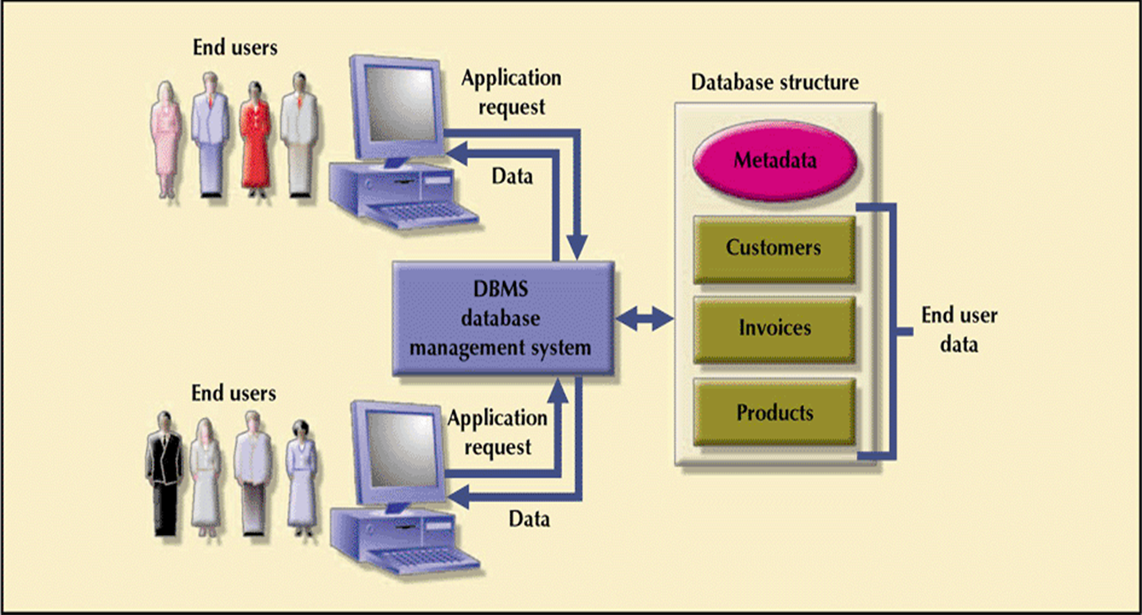
Manages Interaction between end users and database:

Slide 30
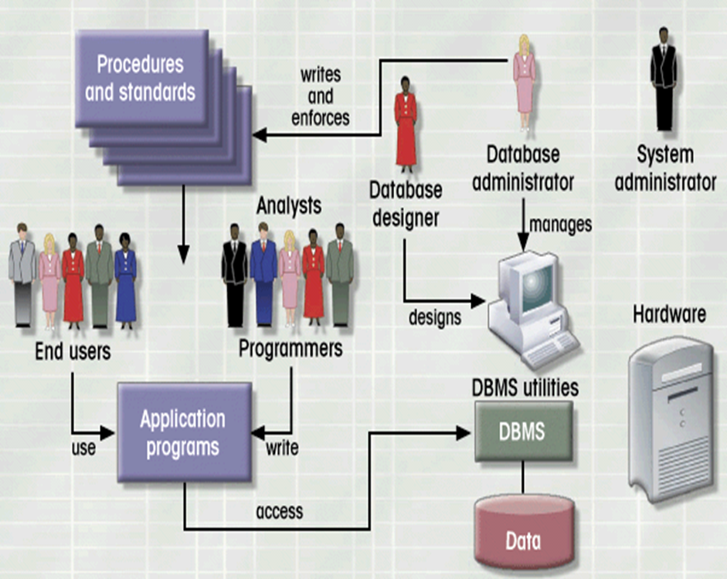
Database System Environment:
Hardware
Software - OS - DBMS - Applications
People
Procedures
Data

Slide 31
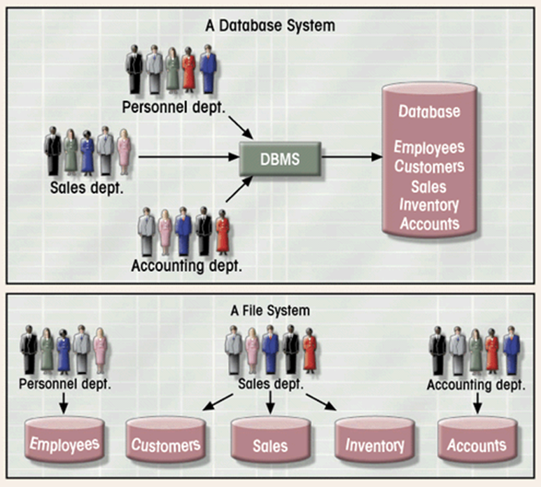
Database System vs. File System

Slide 32
Advantages of Using the DBMS Approach
Controlling redundancy
Sharing of data among multiple users.
Restricting unauthorized access to data.
Providing persistent storage for program
Providing Storage Structures and Search Techniques for Efficient Query Processing
Providing backup and recovery services.
Providing multiple interfaces to different users.
Representing complex relationships among data.
Enforcing integrity constraints on the database.
Drawing Inferences and Actions using rules

Slide 33
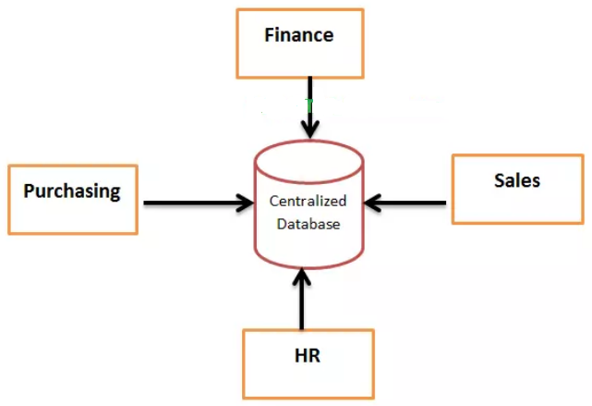
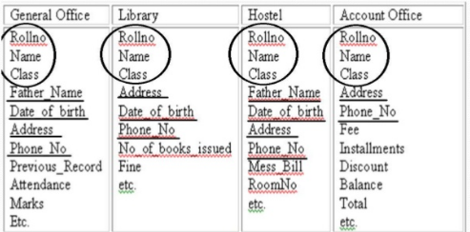
1. Controlling redundancy
Redundancy is storing the same data multiple times at several places, this leads to several problems,
First, It leads to duplication of efforts.
Second, Storage space is wasted.
Third, files that represent the same data may become be inconsistent.
However, in practice, it is sometimes necessary to use controlled redundancy to improve the performance of queries.

Slide 34

2. Restricting unauthorized access to data
When multiple users share a large database, it is likely that most users will not be authorized to access all information in the database.
A DBMS should provide a security and authorization subsystem, which the DBA uses to create accounts and to specify account restrictions and privileges.
Database

Slide 35
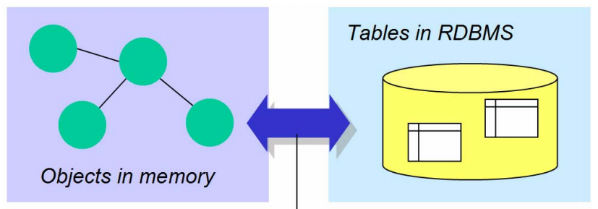
3. Providing persistent storage for program objects
Object Oriented Databases can be used to provide persistent storage for program objects and data structures.
Programming languages typically have complex data structures, such as structs or class definitions in C++ or Java.
Impedance mismatch is nothing but mismatch of data structures wrt DBMS and Programming languages, which requires conversion.

Slide 36
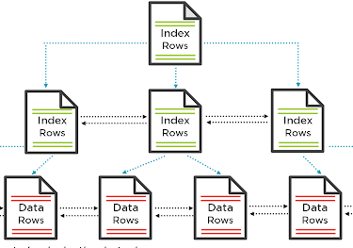
4. Providing Storage Structures and Search Techniques for Efficient Query Processing
Auxiliary files called indexes are often used for this purpose. Indexes are typically based on tree data structures or hash data structures that are suitably modified for disk search.
DBMS has Buffering Module to keep some data in main memory.
The query processing and optimization
module of the DBMS is responsible
for choosing an efficient query
execution plan for each query
based on the existing storage structures.

Slide 37
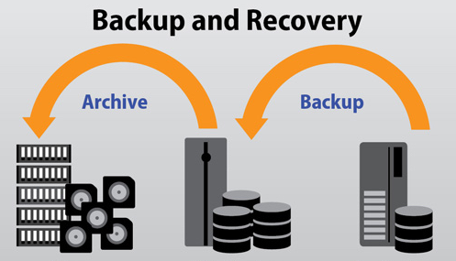
5. Providing Backup and Recovery
A DBMS must provide facilities for recovering from hardware or software failures.
The backup and recovery subsystem of the DBMS is responsible for recovery.
Disk Back up is important in case of catastrophic disk failures.

Slide 38

6. Providing Multiple User Interfaces
Command codes for parametric users
Menu-driven interfaces and natural language interfaces for standalone users
Forms
Query languages for casual users
Database
Programming language interfaces
for application programmers
Mobile apps

Slide 39
7. Representing Complex Relationships among Data
A DBMS must have the capability to represent a variety of complex relationships among the data, to define new relationships as they arise, and to retrieve and update related data easily and efficiently.
8. Enforcing Integrity Constraints
The simplest type of integrity constraint involves specifying a data type for each data item.
Similarly there are referential integrity key or uniqueness constraint.
A data item may be entered erroneously and still satisfy the specified integrity constraints, DBMS can’t handle such things.

Slide 40
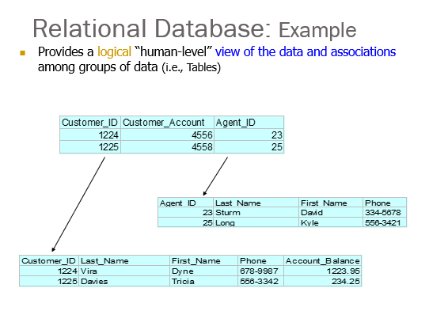

Slide 41
9.Permitting Inferencing and Actions Using Rules and Triggers
Some database systems provide capabilities for defining deduction rules for inference new information from the stored database facts.
A trigger is a form of a rule activated by updates to the table, which results in performing some additional operations to some other tables, sending messages, and so on. More involved procedures to enforce rules are popularly called stored procedures.
10.Additional Implications of Using the Database Approach
Potential for Enforcing Standards
Reduced Application Development Time
Flexibility
Availability of Up-to-Date Information
Economies of Scale

Slide 42
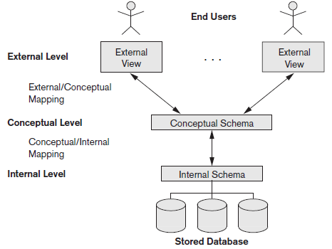
Three-Schema Architecture
The goal of three schema architecture is to separate the user applications from the physical
database

Slide 43
Three-Schema Architecture and Data Independence
The internal level has an internal schema, which describes the physical storage structure of the Database. The internal schema uses a physical Data model and describes the complete details of Data storage and access paths for the Database.
The conceptual schema hides the details of physical storage structures and concentrates on describing entities, Data types, relationships, user operations, and constraints. Usually, a representational Data model is used to describe the conceptual schema.
The external or view level includes a number of external schemas or user views. Each external schema describes the part of the Database that a particular user group is interested in and hides the rest of the Database from that user group.

Slide 44
Data Independence
Data independence: It is defined as the capacity to change the schema at one level of a Database system without having to change the schema at the next higher level
Logical Data independence is the capacity to change the conceptual schema without having to change external schemas or application programs.
2. Physical Data independence is the capacity to change
the internal schema without having to change the
conceptual schema. Hence, the external schemas need
not be changed as well.

